Slide 1
CLV Analysis for Oberalp Sales Data
Abhishek Bargujar & Burak Toptaş
Capstone Project
Free University of Bolzano
Supervisor: Floriano Zini

Slide 2
What is CLV?
CLV is a key metric in customer relationship management. It estimates the total revenue a customer will generate over their engagement with a business.
Challenges in CLV Prediction
Traditional CLV estimation methods often fail to capture seasonal purchasing behaviors, customer churn trends and long-term engagement patterns. Machine learning provides a more robust and data-driven approach to CLV prediction.
Why is CLV important?
Businesses use CLV to optimize customer acquisition costs and personalize marketing efforts, ensuring that they focus on high-value customers.

Slide 3
Problem Statement
What are the challenges?
Our goal
Accurately predicting CLV is challenging because customer behavior is highly dynamic and non-linear. Transactions are not evenly distributed and spending patterns vary across different customer segments.
Many businesses rely on heuristic-based formulas, which often fail to account for outliers, seasonality, and changing trends. This can lead to misallocation of marketing resources.
Our goal was to compare traditional CLV estimation formulas with machine learning models to determine the most reliable approach for predicting future customer revenue.

Slide 4
Data Sources
The dataset consists of E-commerce and Retail transaction records from Salewa, covering 2023 and 2024.
Importance of Oberalp ID
We found that customers with Oberalp ID who made purchases both in 2023 and 2024 tend to have higher CLV, making this an important segmentation feature.
Key attributes included in the dataset:
Customer ID: Unique identifier for each customer.
Transaction Dates: When purchases were made.
Product Codes: Details about purchased products.
Revenue: The amount spent by the customer.
Oberalp ID: Identifies whether the customer belongs to a specific loyalty segment.

Slide 5
Data Preparation & Cleaning
Data integration
Final Dataset
We merged E-commerce and Retail datasets into a single unified dataset. Several Cleaning processes are included like:
Filtering Salewa transactions and standardizing date formats.
Filtering out some transactions (negative revenue, missing EAN codes).
Ensuring consistent revenue information for each transactions.
After preprocessing, we had over 1.7 million(in total) and 61,000 transactions(for 2023-2024 years), making it suitable for training machine learning models.

Slide 6
CLV Calculation Approaches
We explored three different approaches for CLV calculation:
Formula-Based CLV Calculation: Uses the formula (Monetary Value × Frequency) / (Frequency + 1). While simple, it lacks predictive power.
BG/NBD Model: A probabilistic model used in marketing analytics. However, our experiments showed it failed to provide high accuracy (above 63%), especially with outliers.
ML Models: These captured non-linear trends and customer purchase behaviors more effectively.
Key Finding
Machine learning significantly outperformed traditional approaches in terms of accuracy and generalizability.

Slide 7
Feature Engineering for CLV Prediction
Why feature engineering is important?
Features Created
Customer lifespan: The number of days since the first recorded purchase.
Average time between purchases: Helps determine if a customer is a frequent buyer or an occasional shopper.
Purchase frequency ratio: Higher values indicate more engagement.
Log transformations for monetary values: Used to handle skewed revenue distributions.
Raw data lacks predictive power. Extracting meaningful features helps models understand patterns in customer behavior.

Slide 8
Machine Learning Models Used
Multi-Layer Perceptron (MLP): A deep learning model designed to capture hidden patterns in customer behavior, but it struggled with overfitting due to outliers in the dataset.
XGBoost (XGB): A gradient boosting algorithm known for its ability to model non-linear relationships and handle missing data effectively. It provided the best CLV predictions in our experiments.
Extra Trees Regressor (ETR): An ensemble learning technique that creates multiple decision trees to reduce overfitting and increase stability.
Why Machine Learning?
Formula-based models failed to account for customer churn trends, seasonal fluctuations, and high-value outliers.

Slide 9
Model Training & Evaluation
With Train-Test Split, We used 80% of the data for training and 20% for testing to evaluate model performance.
Results
XGBoost had the highest R² Score (0.97), indicating it explained the most variance in CLV.
Metrics Used
Mean Absolute Error (MAE): Measures the average difference between actual and predicted CLV.
Root Mean Square Error (RMSE): Captures the variance in errors.
R² Score: Explains how much of the CLV variance is captured by the model.

Slide 10

CLV Prediction for 2024 & 2025
For 2024
For 2025
The model achieved 96.5% accuracy in predicting CLV values.
Machine learning captured spending behaviors better than traditional methods.
Accuracy dropped to 87%, highlighting the challenge of predicting CLV for longer timeframes.
More historical data introduced uncertainty and reduced accuracy.

Slide 11
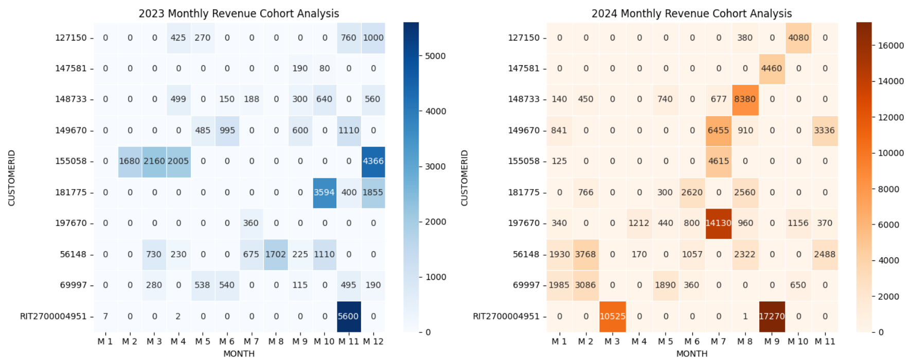
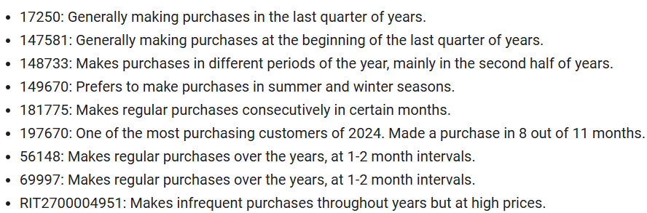
Seasonal & Customer Behavior Analysis
Customer Segments (Oberalp ID Impact):
Customers with Oberalp ID consistently had higher CLV.
Loyalty-based segmentation could improve CLV forecasting.

Slide 12
Challenges & Findings
Challenges Encountered
Key Findings from the Project
CLV is complex and non-linear, making generalization difficult.
Data Limitations:
Outliers significantly impacted accuracy.
Customers had inconsistent transaction histories across different years.
Longer timeframes led to lower model accuracy. Predictions for 2025 were less reliable than those for 2024.
Machine Learning outperforms formula-based CLV estimation, especially for long-term forecasts.
XGBoost provided the most accurate results, but struggled with outliers.
Predictive accuracy drops over time due to data uncertainty.
High CLV is associated with customers having an Oberalp ID, meaning loyalty segmentation is valuable.

Slide 13
Conclusion
Future Improvements
Conclusion
Machine learning significantly improves CLV prediction, but model performance depends on data quality and feature engineering.
XGBoost was the best model but struggled with long-term forecasts.
Seasonality and segmentation (Oberalp ID) play a crucial role in CLV analysis.
Future research should explore hybrid approaches combining machine learning with statistical models.
Refining Features: Adding behavioral metrics such as customer engagement.
Advanced Models: Experimenting with deep learning (LSTMs) or time-series models (Prophet, ARIMA).
Data Collection Improvements: Gathering more real-time customer data to improve predictions.

